Slide 1

Major League Baseball Swing Type Analysis
Jacob Parker
7/28/2025

Slide 2

Introduction: Baseball
What is baseball?
Basic overview
Video
How can we measure performance?
Goal: score runs
Not the best way to evaluate future performance

Slide 3
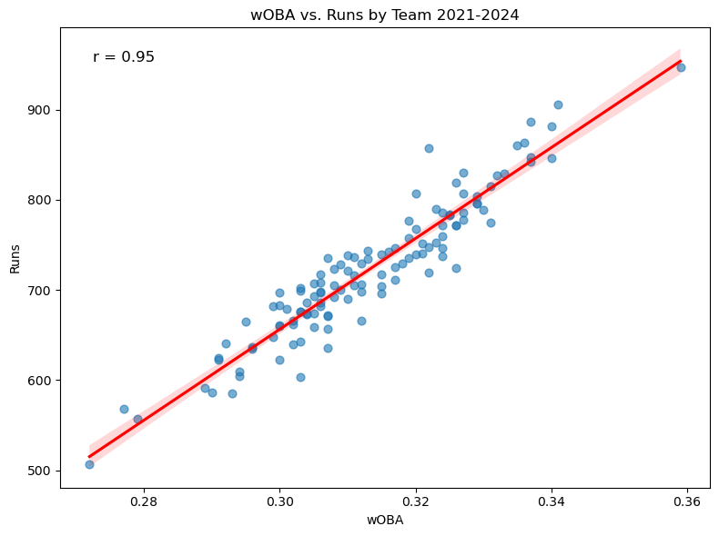
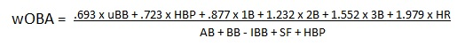
Introduction: Weighted On-Base Average (wOBA)
Weighted Average of all possible hitting outcomes
Higher wOBA = better results
Main Response variable (maximize)
A measure of everything that goes into creating runs

Slide 4
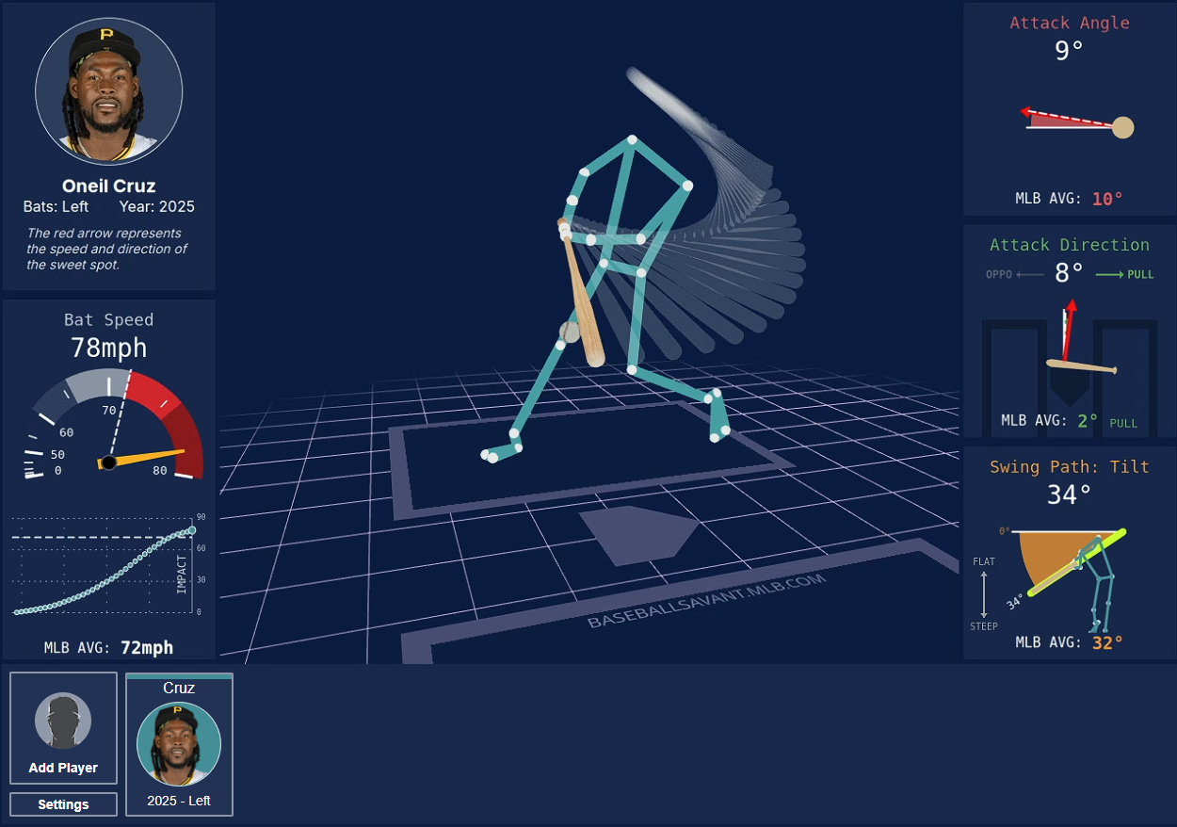
Data Sources
Sources:
Fangraphs Leaderboards
Fangraphs.com
Baseball Savant
BaseballSavant.com
Data Requirements:
Time Frame: 03/01/2023 – 07/18/2025)
Players > 300 Competitive swings
Definition: the fastest 90% of a player’s swings plus any swings that result in an exit velocity of 90+ mph
500 instances

Slide 5
Data Variables: Cooking Comparison
Ingredients: How the batter moves (speed, angle, position)
Raw mechanics of the swing
Cooking Process: What happens immediately after swing (contact quality and ball behavior)
Direct consequence of swing mechanics
Final Dish: The ultimate value of what was made
Final, measurable result
Swing Data (Input) |  |  | Batted Ball Data (Output and Input) |  |  | Result (Output)
Variable | Description | Type | Variable | Description | Type | Variable | Description | Type
avg_bat_speed | average swing speed (mph) | Continuous (mph) | pull_air_rate | % of balls pulled in the air | Proportion (0-1) | wOBA | weighted on base average | Continuous (proportion)
swing_length | length of swing (feet) | Continuous (feet) | EV | average exit velocity | Continuous (positive)
swing _tilt | bat tilt angle | Continuous (angle) | LA | average launch angle | Continuous (angle)
attack angle | vertical swing angle | Continuous (angle) | barrel_per | % of barreled balls | Proportion (0-1)
attack direction | horizontal swing direction | Continuous (angle) | hard_hit_per | % of balls hit > 95 mph | Proportion (0-1)
ideal_attac_angle_rate | % of swings in ideal angle | Proportion (0-1) | z_contact_per | contact rate on strikes | Proportion (0-1)
avg_batter_x_position | horizontal position in batter's box | Continuous (feet)
avg_intercept_y_vs_plate | vertical swing at contat vs.plate | Continuous (feet)
avg_intercept_y_vs_batter | vertical swing at contat vs. batter | Continuous (feet)

Slide 6
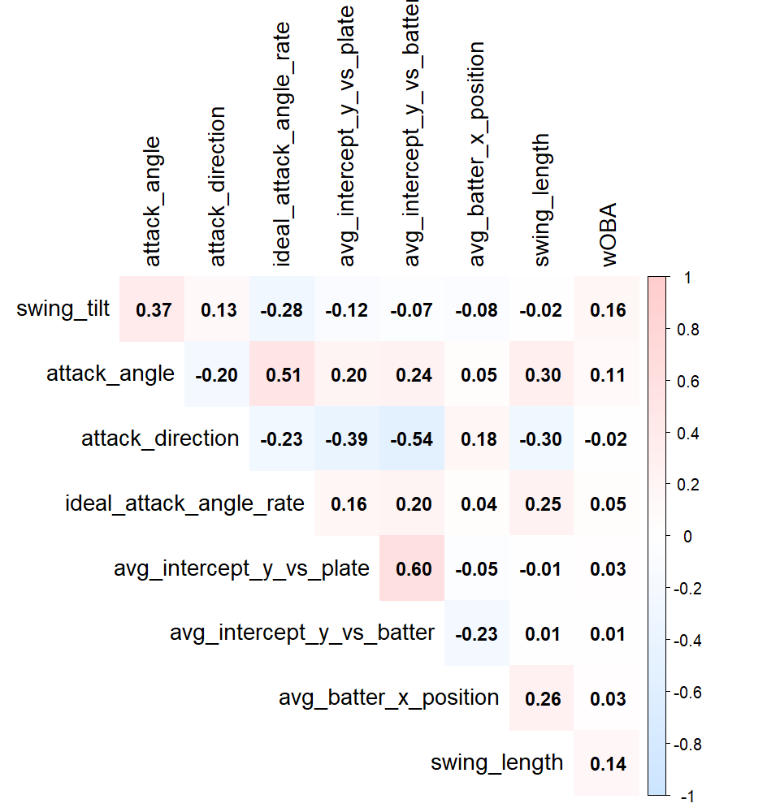

Data: Swing Metrics vs. Output
Very poor correlation between swing mechanics and Output
There isn’t a single “right” way to swing a bat
How can we analyze swing mechanics?
K-means clustering
ANOVA

Slide 7
Objectives
Perform k-means clustering
Identify natural groupings within the data based on swing characteristics
Compare swing types between clusters
Determine whether certain swing types (e.g., swing length, attack angle) differ across clusters
Assess the impact of swing types on performance
Investigate whether certain swing traits are associated with higher or lower outcomes such as:
Launch angle
Contact rate
Exit velocity
Analyze trends within clusters
Evaluate how relationships between variables (e.g., bat speed and wOBA) differ by cluster
Test differences in correlation strength
Use Fisher’s Z transformation to test whether correlations (e.g., bat speed vs. wOBA) are significantly different across clusters and compared to the full population.

Slide 8
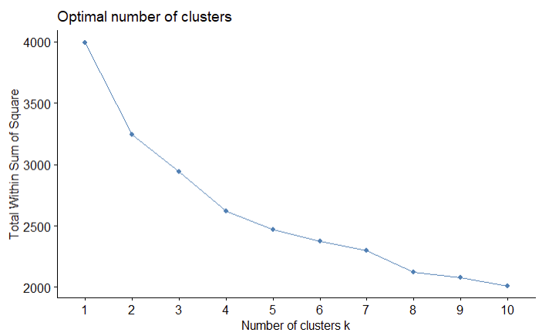
Data Analysis and Pre-Processing: K-means Clustering
VIF's of Clustered Variables
Variable | VIF
swing_length | 1.40
swing _tilt | 1.94
attack angle | 2.53
attack direction | 1.72
ideal_attac_angle_rate | 2.10
avg_batter_x_position | 1.22
avg_intercept_y_vs_plate | 1.65
avg_intercept_y_vs_batter | 2.00
Select statistics to cluster
Average Bat Speed omitted (hard to change)
Standardize
Check for multicollinearity
All VIF values < 5
Find optimal number of clusters
From elbow plot, k = 3
k = 4: lower Silhouette Score

Slide 9
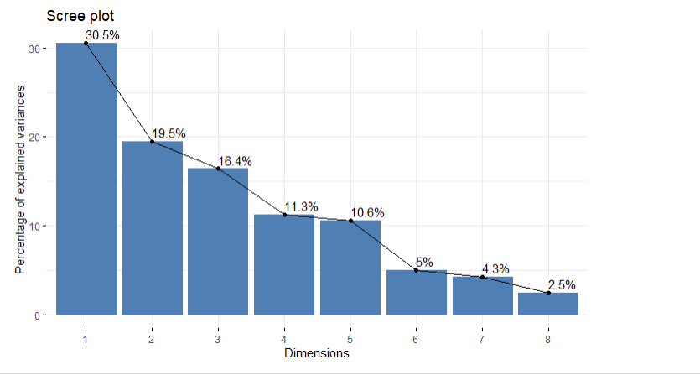
Data Analysis and Pre-Preprocessing: K-means Clustering (cont.)
Silhouette Score by # of PCAs
PCs | Score
2 | 0.332
3 | 0.238
4 | 0.195
5 | 0.166
6 | 0.154
7 | 0.150
8 | 0.151
PCA: Only used PCA1 and PCA 2:
Captured ~50% of total variance
Reduced noise by focusing clustering on major patterns instead of noise-driven variability
Maximized Silhouette Score

Slide 10
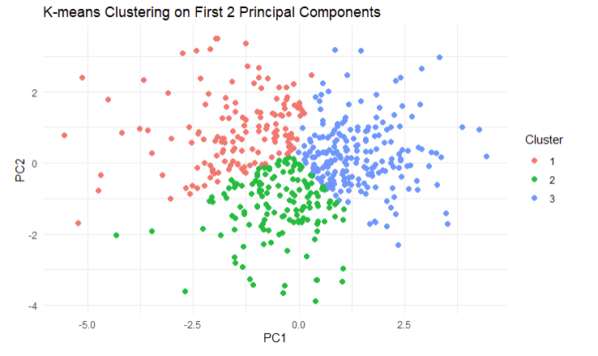
Data Analysis and Pre-Processing: K-means Clustering (final)
Final cluster results:
K-Means applied to top 2 principal components
3 distinct clusters identified, revealing meaningful player groupings
Silhouette Score = 0.332

Slide 11
Cluster Analysis: ANOVA and Tukey’s Post Hoc
At alpha = 0.05, there is sufficient evidence that each variable has at least one cluster that has a different mean than the rest
Tukey’s Post Hoc (see pdf)
If significant = True, there is sufficient evidence to suggest the two clusters have different means of variable X
If significant = False, there is insufficient evidence to suggest the two clusters have different mean variable X
ANOVA differences between clusters
Variable | P_Value | P_Adjusted | alpha = .05?
attack_angle | 3.21E-56 | 5.13E-55 | TRUE
avg_intercept_y_vs_batter | 2.66E-55 | 2.13E-54 | TRUE
ideal_attack_angle_rate | 3.97E-48 | 2.12E-47 | TRUE
attack_direction | 6.11E-43 | 1.80E-42 | TRUE
avg_intercept_y_vs_plate | 6.77E-43 | 1.80E-42 | TRUE
pull_air_rate | 6.11E-43 | 1.80E-42 | TRUE
LA | 5.16E-29 | 1.18E-28 | TRUE
swing_length | 1.11E-26 | 2.22E-26 | TRUE
barrel_per | 4.87E-21 | 8.66E-21 | TRUE
avg_batter_x_position | 6.89E-19 | 1.10E-18 | TRUE
z_contact_per | 2.23E-18 | 3.24E-18 | TRUE
avg_bat_speed | 3.61E-09 | 4.81E-09 | TRUE
hardhit_per | 1.54E-07 | 1.89E-07 | TRUE
EV | 6.93E-06 | 7.92E-06 | TRUE
swing_tilt | 3.66E-05 | 3.90E-05 | TRUE
wOBA | 2.85E-02 | 2.85E-02 | TRUE

Slide 12

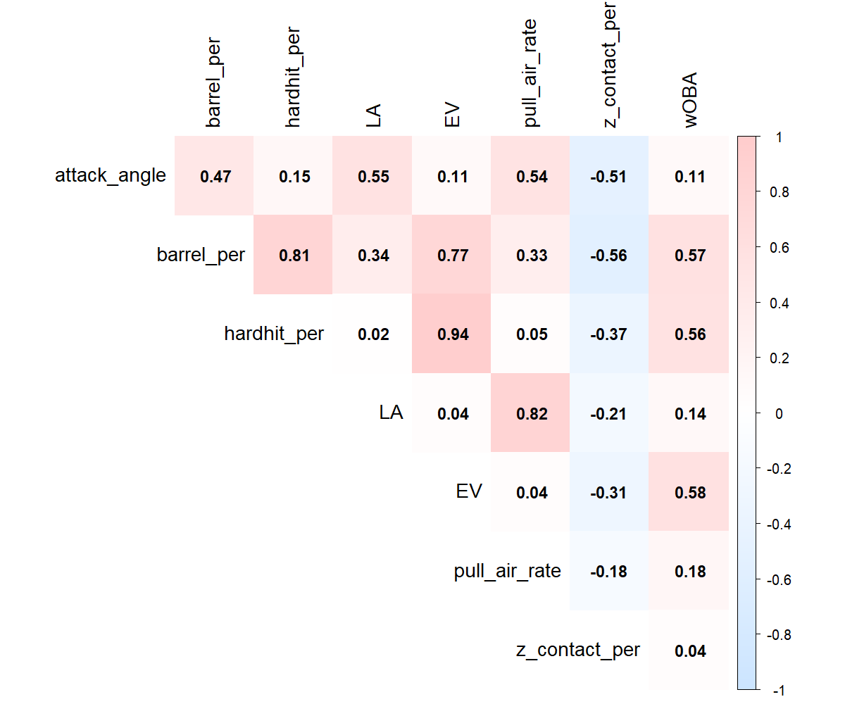
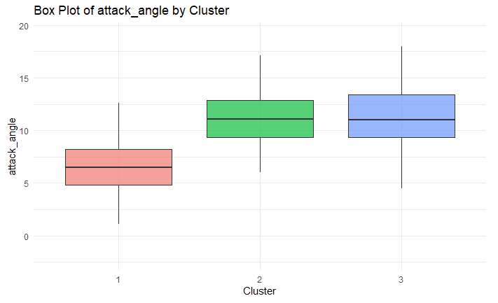
Cluster Analysis: Attack Angle
Tukey's Result: Attack Angle
Comparison | P_Adj | Significant
2-1 | 1.19E-10 | TRUE
3-1 | 1.19E-10 | TRUE
3-2 | 9.00E-01 | FALSE
Cluster 1 has a significantly lower attack angle than Clusters 2 & 3
From correlation matrix, we would expect cluster 1 to have significantly lower Barrel%, Pull Air %, and Launch Angle but create more contact on pitches inside the strike zone

Slide 13
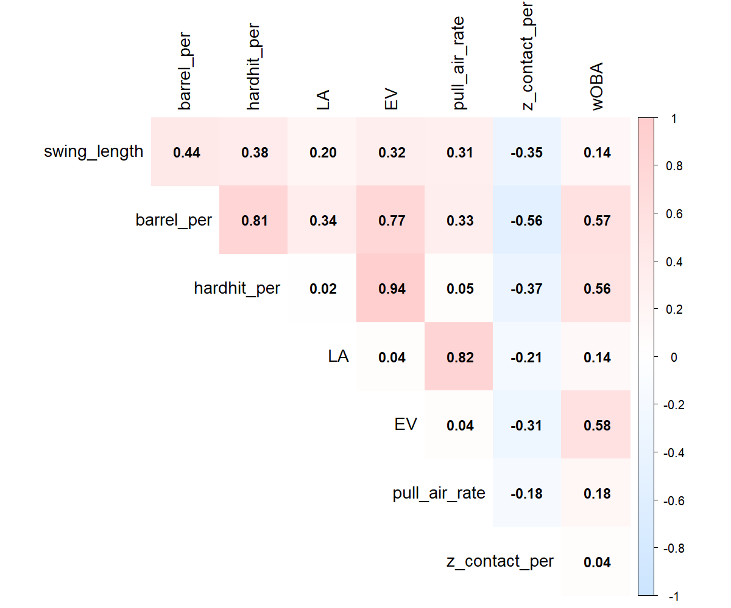
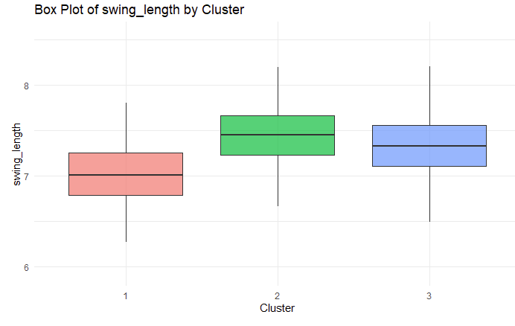
Cluster Analysis: Swing Length
Tukey's Result: Swing Length
Comparison | P_Adj | Significant
2-1 | 1.19E-10 | TRUE
3-1 | 1.19E-10 | TRUE
3-2 | 6.03E-03 | TRUE
Cluster 1 has a significantly lower swing length than Clusters 2 and 3
Cluster 2 has a has a greater swing length than cluster 3 (less significant)
From the correlation matrix, we would expect Cluster 2 to have the highest HardHit%, Barrel%, and EV

Slide 14
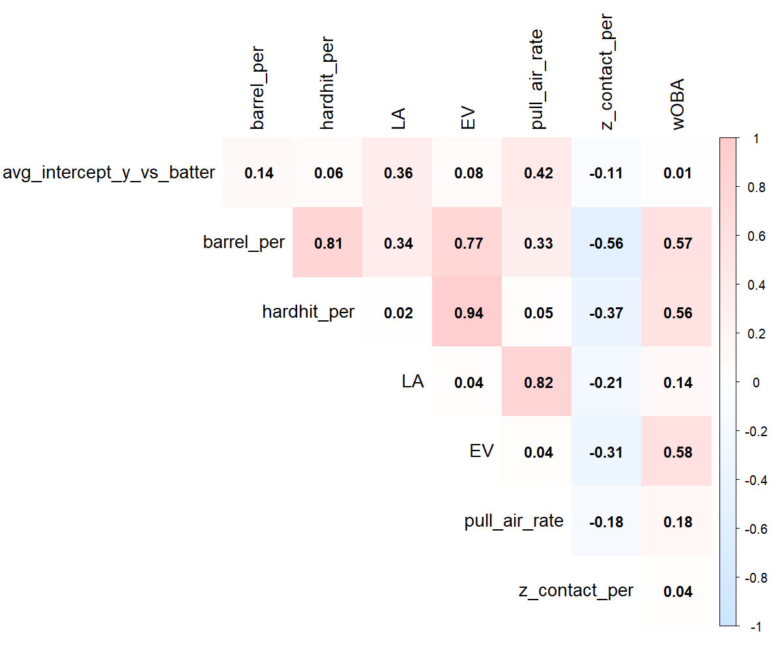
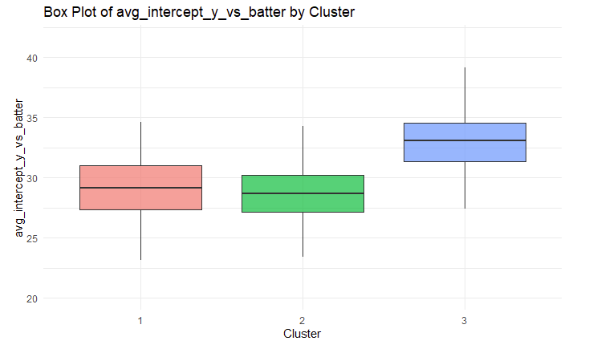
Cluster Analysis: y-intercept vs. batter
Tukey's Result: y-int vs Batter
Comparison | P_Adj | Significant
2-1 | 2.40E-01 | FALSE
3-1 | 1.19E-10 | TRUE
3-2 | 1.19E-10 | TRUE
Cluster 3 has a significantly higher y-intercept vs. batter than Clusters 1 & 2
From the correlation matrix we would expect Cluster 3 to have a significantly higher Launch Angle and Pull Air %

Slide 15
Cluster Analysis: Summary Between Clusters
Cluster 1: Contact Hitters
Low launch angle (groundballs)
Low Barrel % (less ideal contact)
Low Hard Hit % (less hard contact)
High contact % (less strikeouts)
Example: Otto Lopez
Cluster 2: Combination
High Barrel % (more ideal contact)
High Hard Hit % (more hard contact)
Low contact % (more strikeouts)
Example: Pavin Smith
Cluster 3: Power Hitters
High Launch Angle (flyballs)
High Pull Air % (more ideal contact)
Moderate Hard Hit and Barrel %
Example: Max Muncy
Clustering Output Results
Cluster | Pull Air % | EV | LA | Barrel % | Hard Hit % | Zone Contact % | wOBA
1 | 13.95% | 88.19 | 10.24 | 5.45% | 36.38% | 87.81% | 0.302
2 | 16.66% | 89.36 | 12.75 | 9.29% | 41.09% | 83.54% | 0.312
3 | 20.88% | 88.90 | 15.32 | 8.63% | 39.03% | 84.51% | 0.309

Slide 16
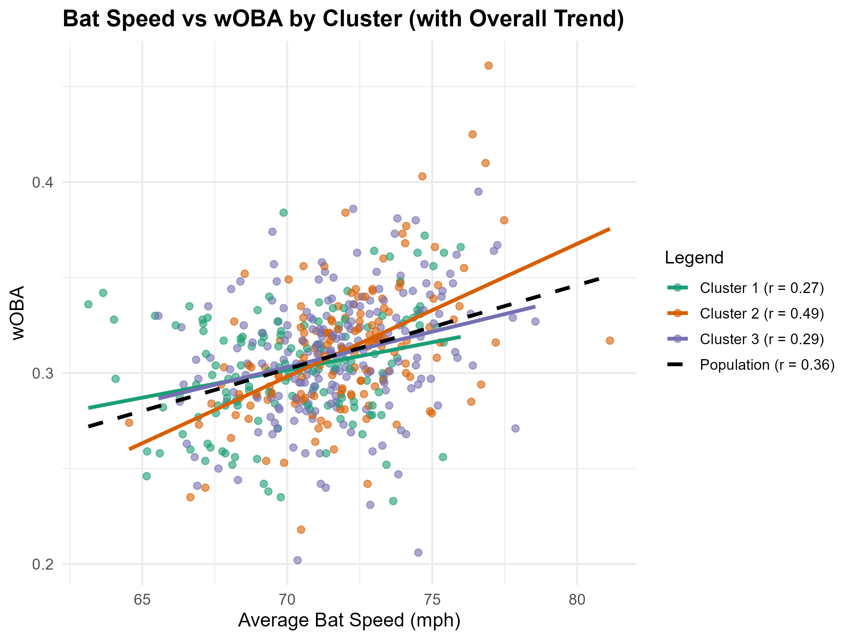
Fisher Test: Cluster 2 Bat Speed
Bat Speed (mph) vs wOBA
Cluster | n | x̄ Bat Speed | x̄ wOBA | r
1 | 144 | 70.24 | 0.302 | 0.27
2 | 151 | 71.99 | 0.312 | 0.49
3 | 205 | 71.70 | 0.309 | 0.29
Pop | 500 | 71.36 | 0.308 | 0.36
Fisher Test:
Bat speed has a significantly higher r value in cluster 2 compared to the population and other clusters
Bat Speed has a significantly greater impact on performance in cluster 2 compared with the others
Fisher's Exact Test: Cluster 2
Comparison | p-value | Result
2 vs. 1 | 1.35E-02 | *
2 vs. 3 | 1.19E-02 | *
2 vs. Pop | 3.07E-02 | *

Slide 17
Observations/Conclusions
Hitters can be separated into three swing types with differing batted ball profiles
Only Clusters 1 and 2 have significantly different response variables (wOBA)
Players in Cluster 2 tend to be more successful with higher bat speeds
Tukey's Result: wOBA
Comparison | P_Adj | Significant
2-1 | 2.82E-02 | TRUE
3-1 | 1.04E-01 | FALSE
3-2 | 7.50E-01 | FALSE

Slide 18
Future Scope:
Pitch Data:
How do clusters perform against high velocity pitching? Off-speed?
Application:
Are there players that would benefit from changing clusters? What adjustments can be made?
Swing Decision Data:
Do players from a particular cluster make better/worse swing decisions?

Slide 19
Acknowledgment
Data:
Baseball Savant
FanGraphs
Coding help:
K-Means Clustering in R: Step-by-Step Example
The R Graph Gallery – Help and inspiration for R charts
Course Resources

